Slide 1
Software System for University Course Registration
SSN College of Engineering
Department of Computer Science and engineering
UCS2265 – Fundamentals and Practice Of Software Development In C
DONE BY:
Sakthivel T – 3122235001111
Saravanan E – 3122235001116
Ramcharan S - 3122235001105

Slide 2
Problem Statement
To Develop a software system for taking care of course registration in a university. This system should have the following features:
Each student should log into the system to register for the chosen courses in each semester.
Once the student logs in, a list of courses that are offered in that semester should be displayed along with the information about the faculty members who are teaching each section of the course.
Student can choose the courses in which they would like to register.
At the end of registration processes, the list of successful allotted courses along with the name of the faculty for each course should be displayed. In addition , the list of waitlisted courses along with the waitlist number should also be displayed.

Slide 3
Constraints
A student should be able to register in a particular course only if he/she has already completed all prerequisites for that course.
Each student should register for a minimum of 4 and a maximum of 6 courses per semester.
Every section will have a fixed strength. If the section fills up, further registration should not be allowed.
A wait list (10% of the class strength) will be maintained in case the allotment is not possible in the first round.
If a student wants to add or drop any course after initial registration, it should be allowed only within the first two weeks after the semester starts.
Students from the waitlist can be allotted their choice subsequent to the processing of drop requests.

Slide 4
Executive summary
The course registration software system can streamline and automate the registration process for students, addressing challenges of the current manual system such as errors, inefficiencies, and limited data for decision-making.
The software should allow students to log in, choose courses with a minimum of four and a maximum of six per semester, and display the list of successfully allotted courses with the teacher's name. Various slots should also be allocated to handle large number of users. A waitlist should also be maintained.
Constraints such as prerequisites, fixed section strength, and a waitlist (10% of the class strength) should be implemented. Students should be able to add or drop courses within the first two weeks after the semester starts.
This problem statement has been explored and referred with various universities like Vellore Institute of Technology, Massachusetts Institute of Technology, Georgia Institute of Technology, University of Michigan and Stanford University.

Slide 5
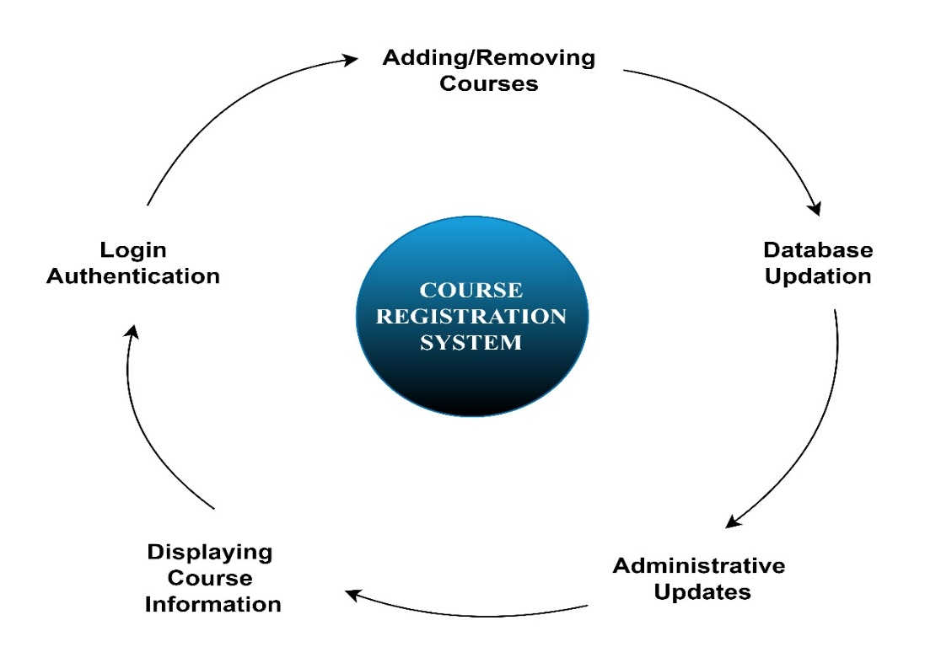
Various stages involved in the process:

Slide 6
Data Flow Diagrams

Slide 7
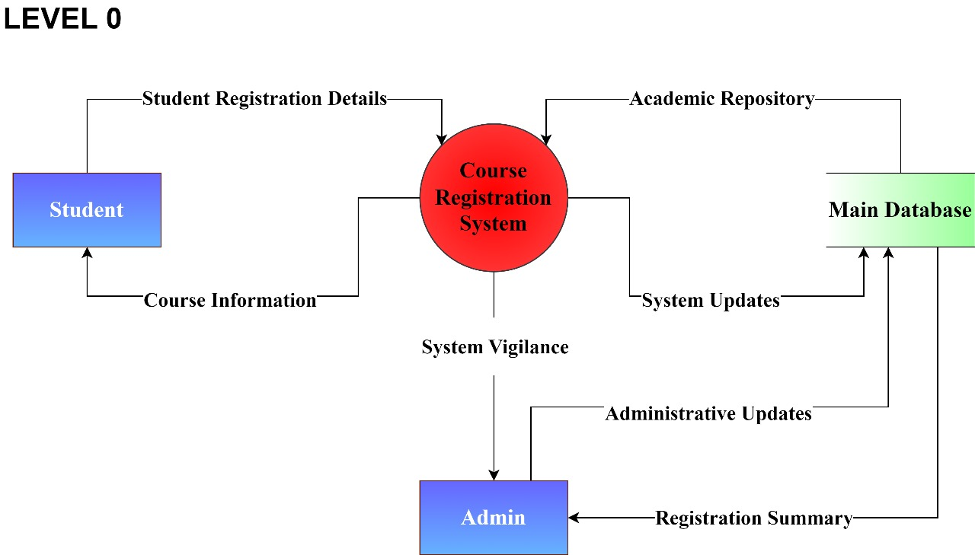

Slide 8
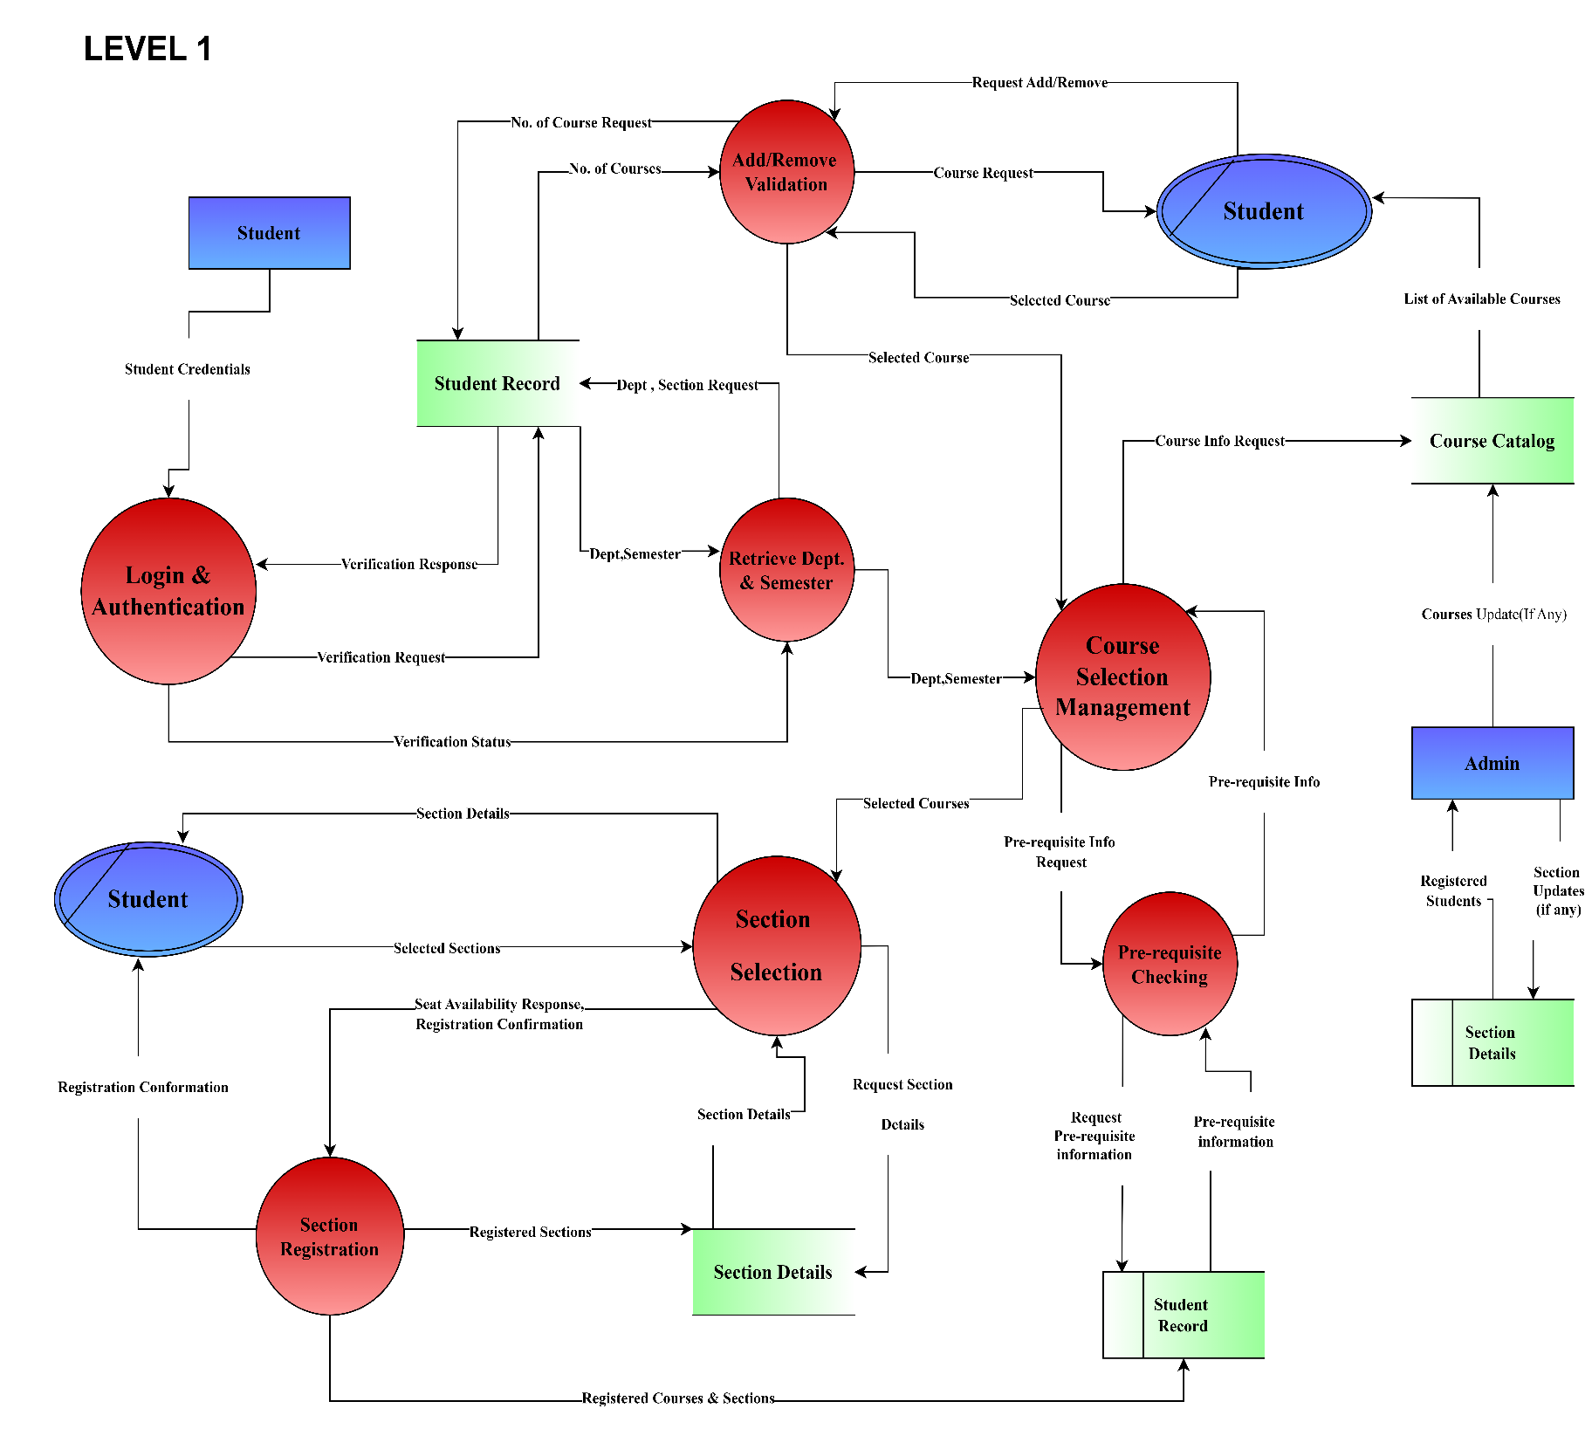

Slide 9
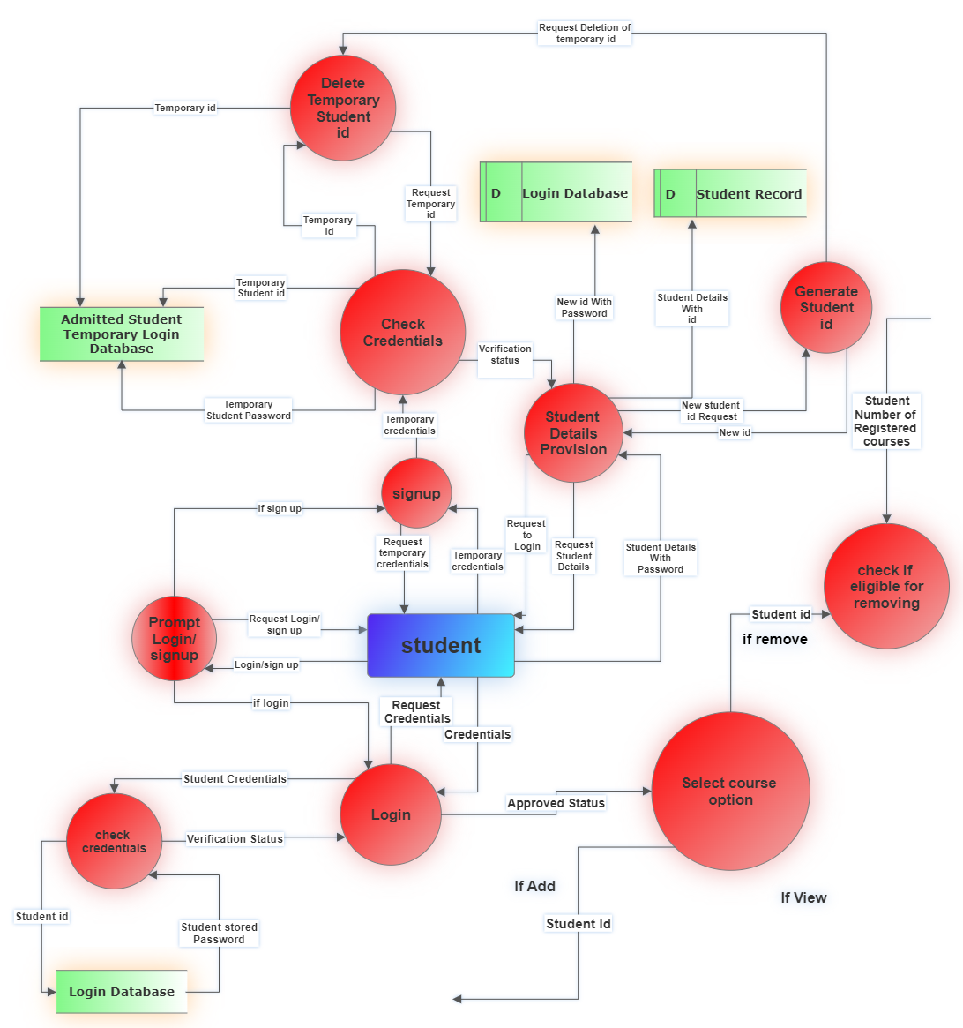
LEVEL 2
Part 1 (Login Processes)

Slide 10
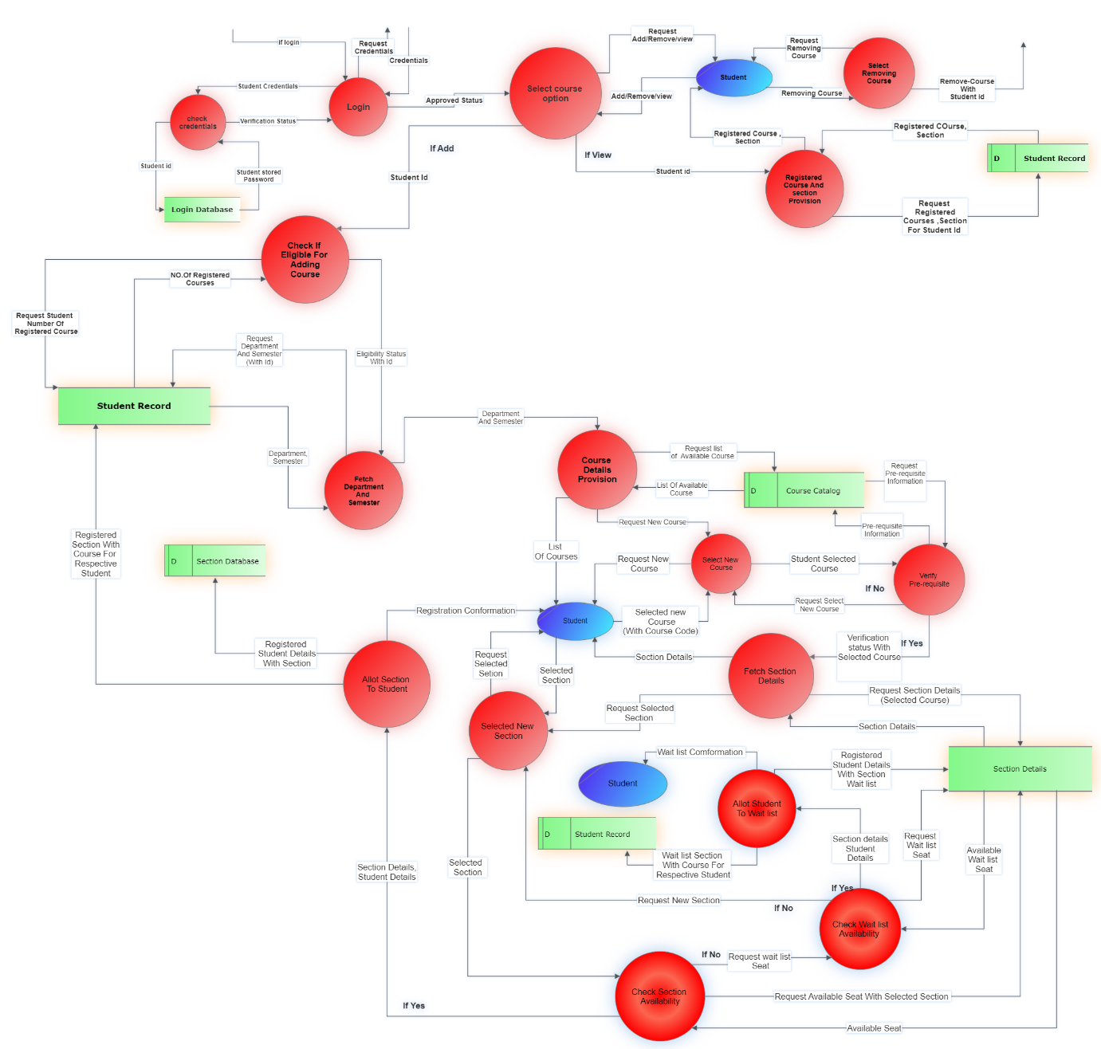
Part 2
(Add
Courses)

Slide 11
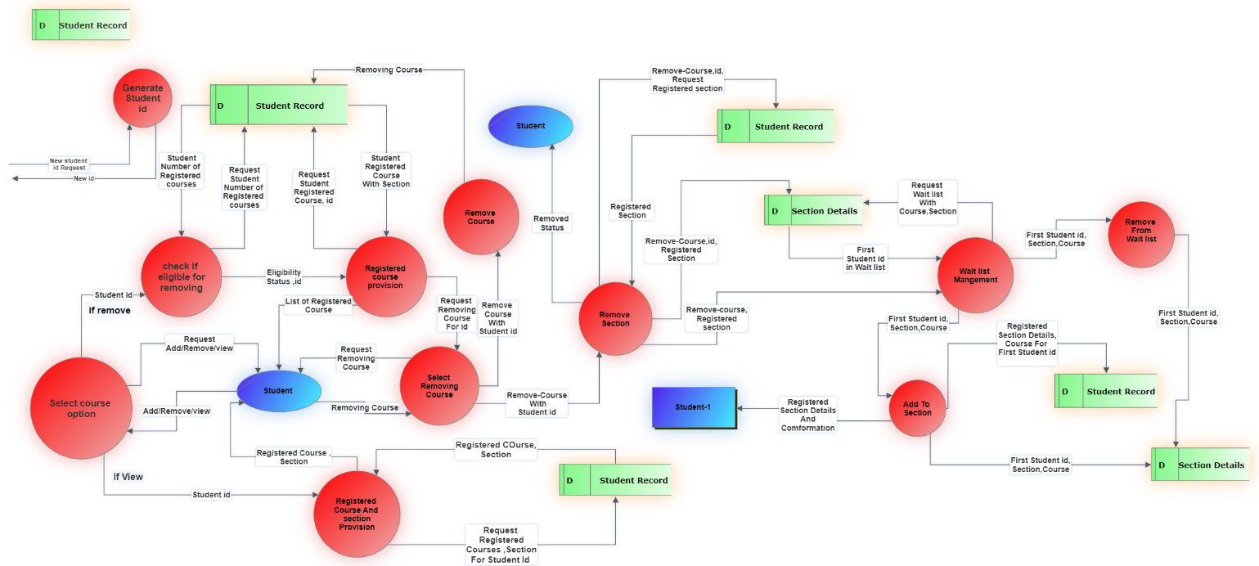
Part 3
(Remove Courses)

Slide 12
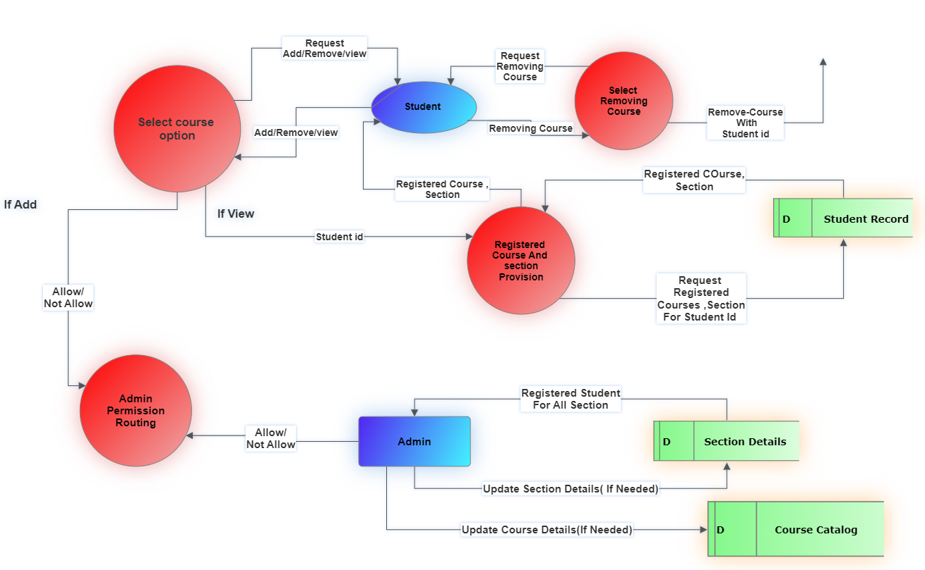
Part 4
(Admin
Control)

Slide 13
Architectural diagram

Slide 14
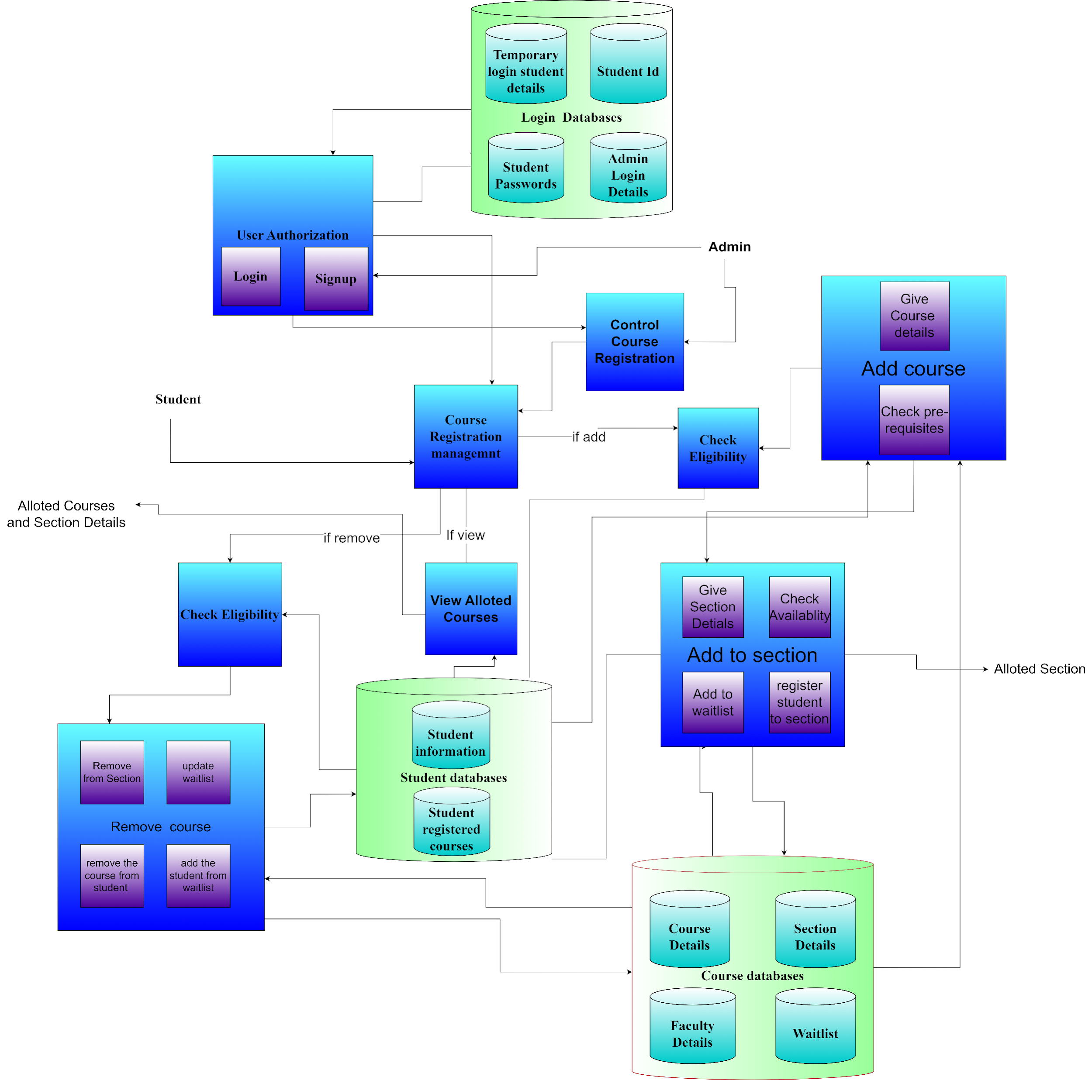

Slide 15
Flowcharts

Slide 16
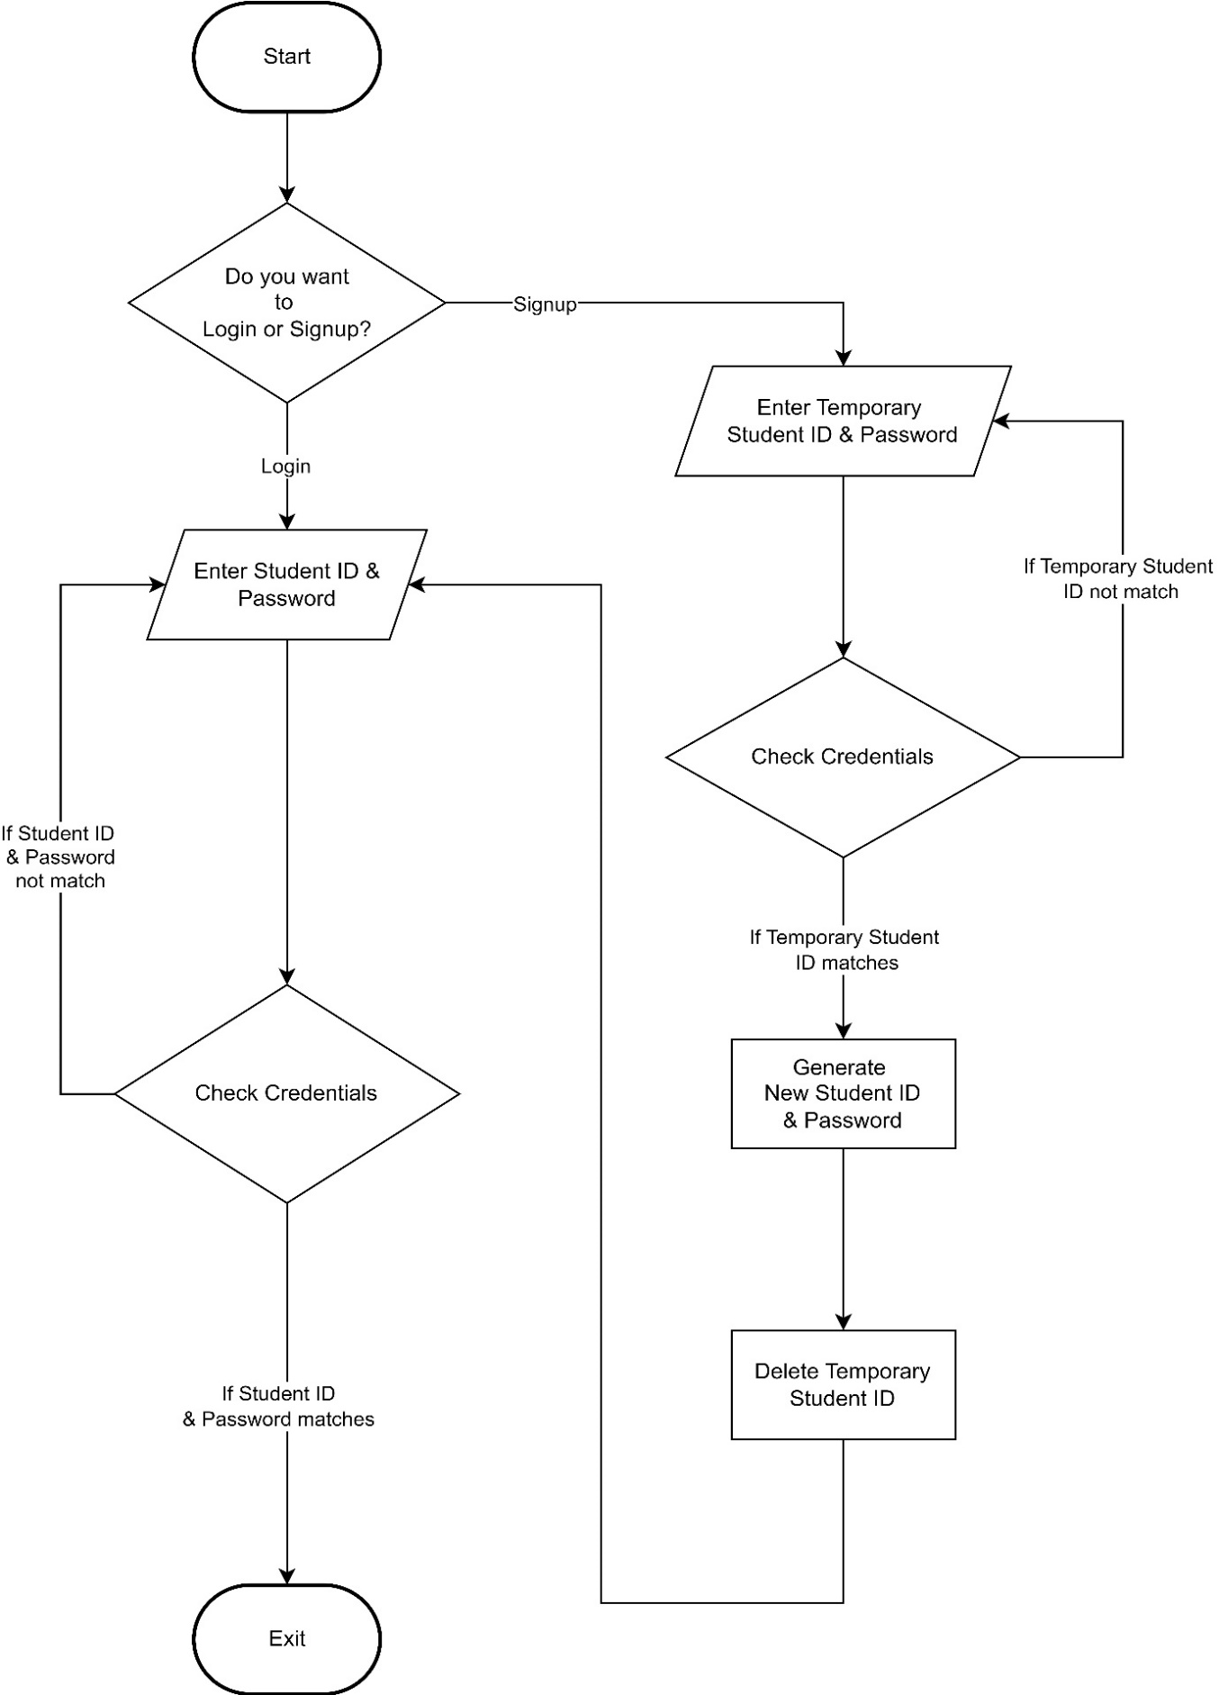
Login Authentication

Slide 17
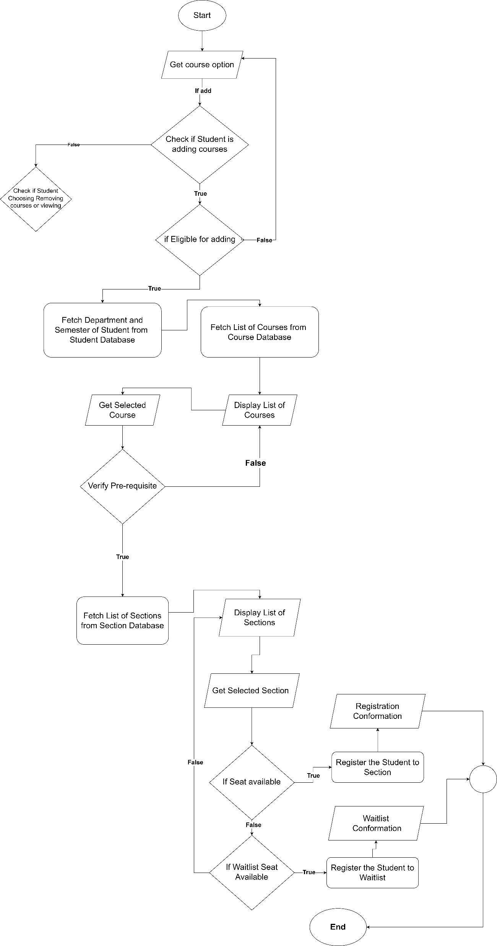
Adding Courses

Slide 18
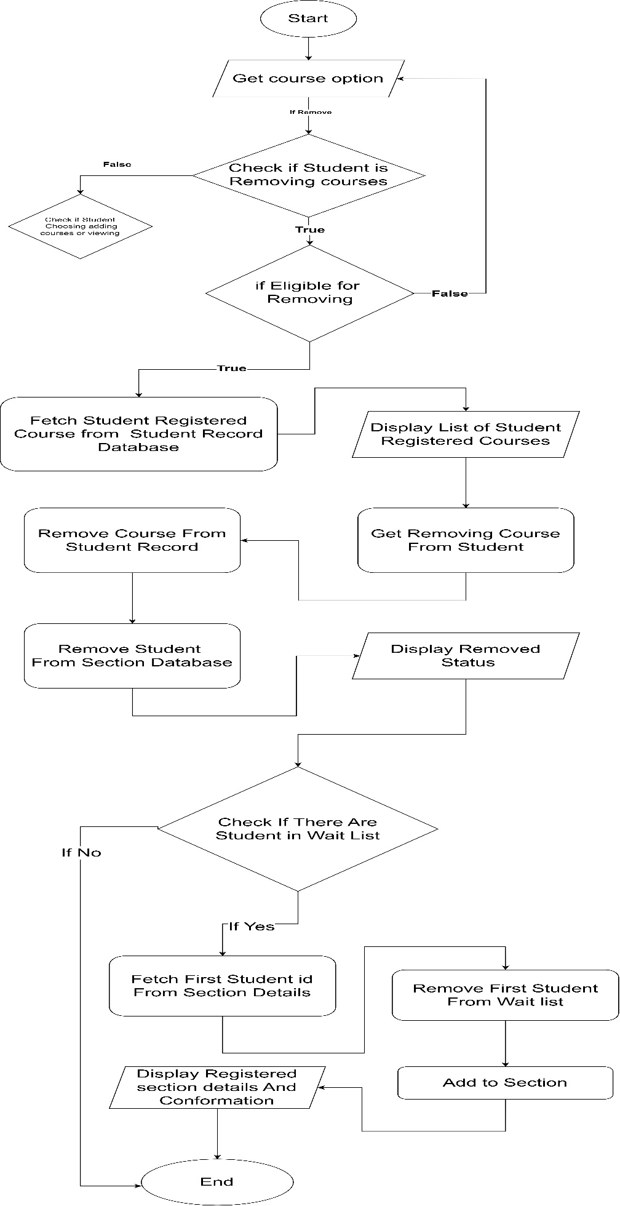
Removing Courses

Slide 19
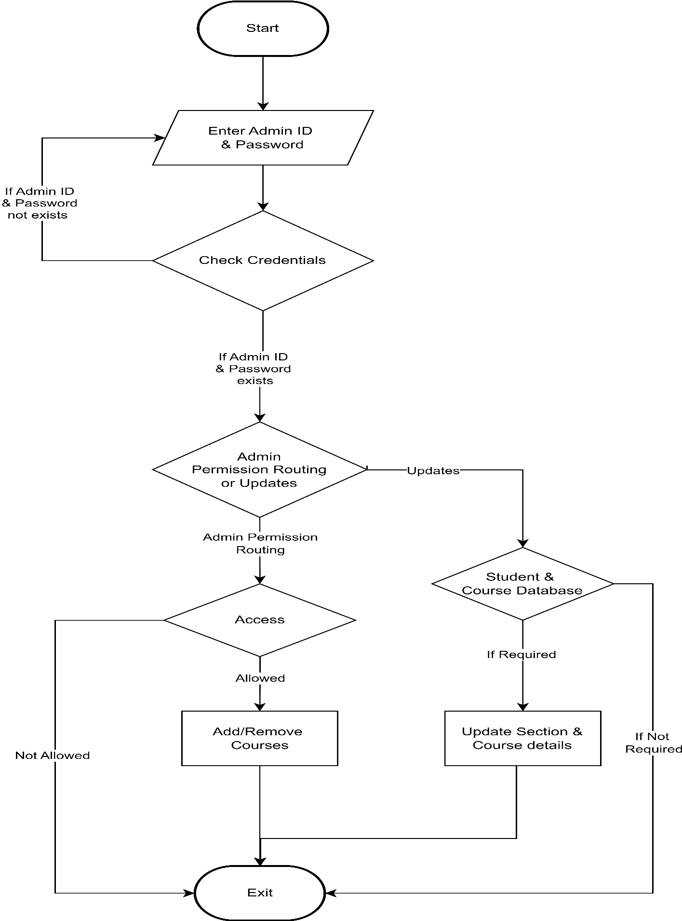
Admin Control

Slide 20
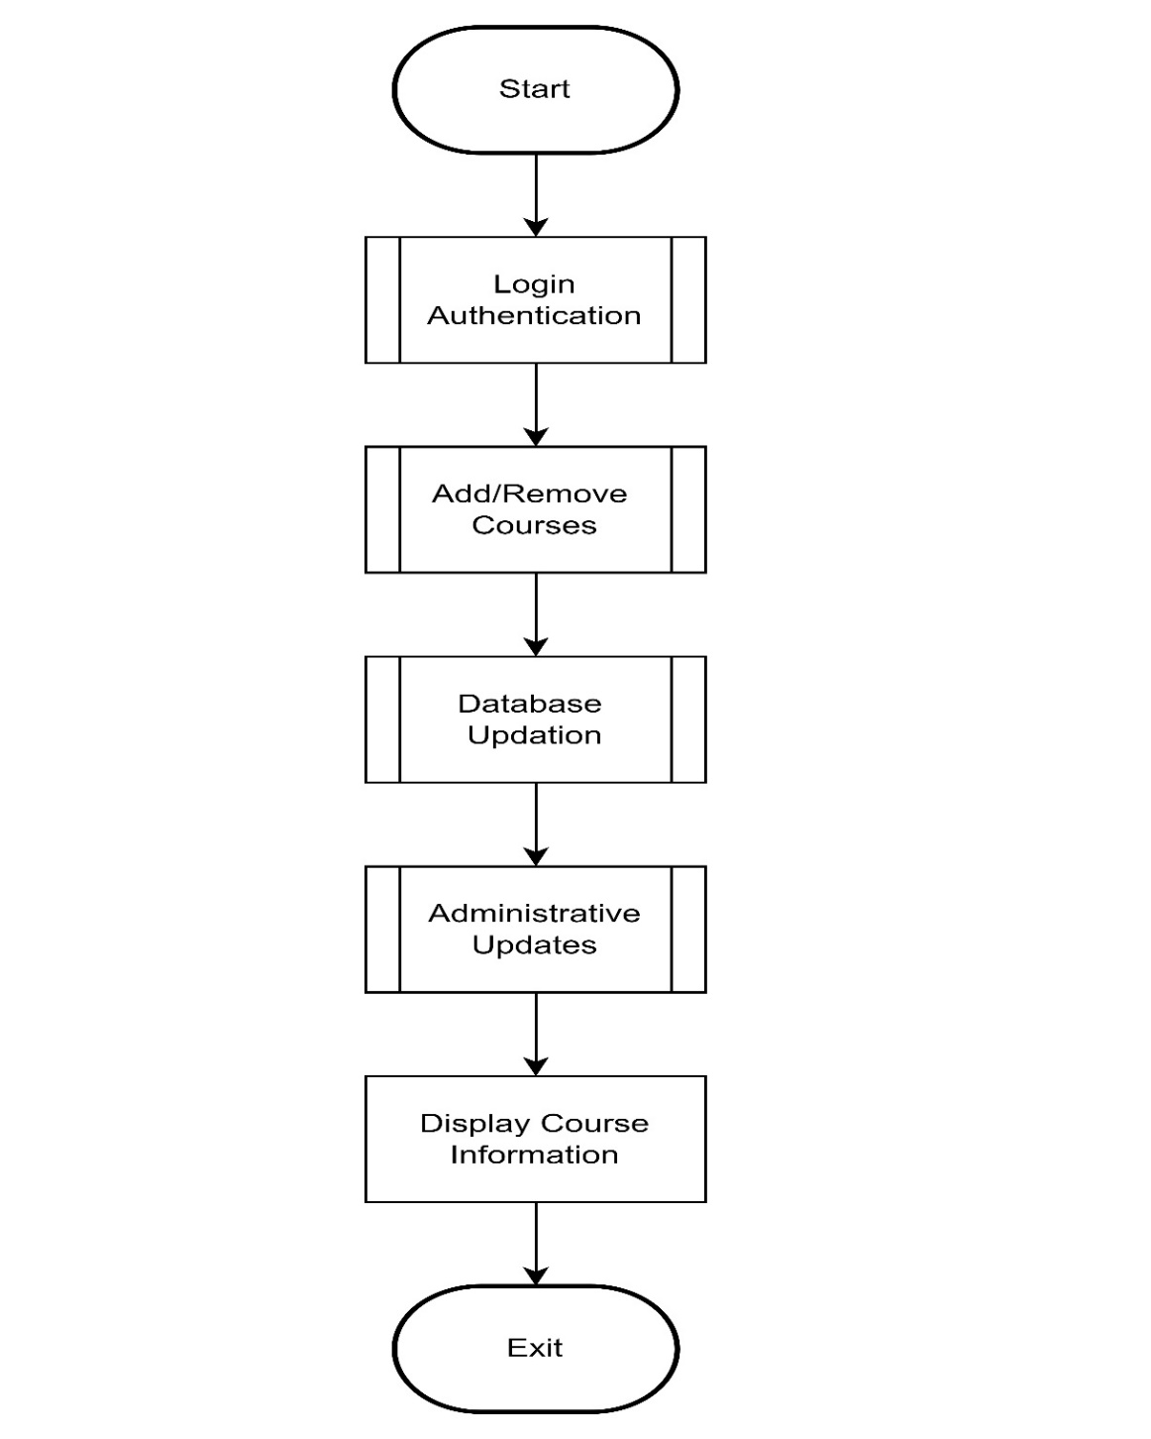
Overall Structure of Modules

Slide 21
Non-Functional Requirements
Performance Requirements:
The system will be able to handle large number of simultaneous users during peak registration times. It will also respond quickly to user requests to ensure a smooth registration process.
This is done by allocating slots with various parameters like grade point average,extra curricular activities etc.. with the help of machine learning.
Security Requirements:
The system protects sensitive student information and prevent unauthorized access.
This includes implementing strong password policies, encryption, and secure protocols.
This is by using hashing algorithms, which take the original password and transform it into a fixed-size string of characters.
This string is then stored in the database instead of the plaintext password.

Slide 22
Non-Functional Requirements
Usability Requirements:
The system will be user-friendly, with an intuitive interface that students can navigate easily which will be done by using GTK library.
It will also provide clear error messages and help documentation.
Scalability Requirements:
The system will be able to scale to accommodate increasing numbers of students or courses without a significant decrease in performance with the help of machine learning.
Legal and Regulatory Requirements:
The system will comply with all relevant laws and regulations, such as data protection and privacy laws.
Testability Requirements:
The system will be designed in a way that it can be easily tested.
This includes having clear specifications, modular design, and the ability to monitor system performance.

Slide 23
Scope and Limitation
The project has some of the following potential scopes:
Online Course Registration: The system can be developed to allow students to register for courses online, providing a convenient and flexible registration process.
Automated Prerequisite Checking: The system can be designed to automatically check if a student has completed the necessary prerequisites for a course, reducing errors and saving time.
Real-Time Course Availability: The system can provide real-time information on course availability, allowing students to see which courses are full and which ones still have spots available.
Waitlist Functionality: The system can include a waitlist functionality, allowing students to join a waitlist for a full course and be notified if a spot becomes available.
Personalized recommendation: The system provides personalised recommendations based on a student’s academic history with the help of machine learning.

Slide 24
Scope and Limitation
The project may also have some of the following limitations:
Limited Course Availability: One of the main limitations of a course registration system is the limited availability of courses. Once a course is full, students may have to wait for a spot to open up or choose an alternative course.
Lack of Personal Interaction: Course registration systems can lack the personal interaction that comes with registering for courses in person, which can make it difficult for students to get answers to their questions or receive guidance on course selection.
Limited Options for Courses with Inter-disciplinary Components: When there are limited options for interdisciplinary or cross-listed courses, it means that there are few courses that are offered by multiple departments, which can limit the opportunities for students to explore different fields of study.
Lack of Notification about Course Changes or Cancellation: The course registration system may fail to notify students about changes or cancellations in a timely manner, causing inconvenience and confusion. This can result in students missing important updates to course content or requirements.

Slide 25
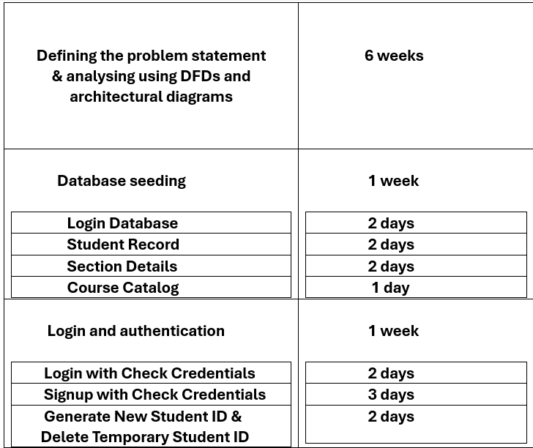
Timeline For Completing Each Modules And For Testing

Slide 26
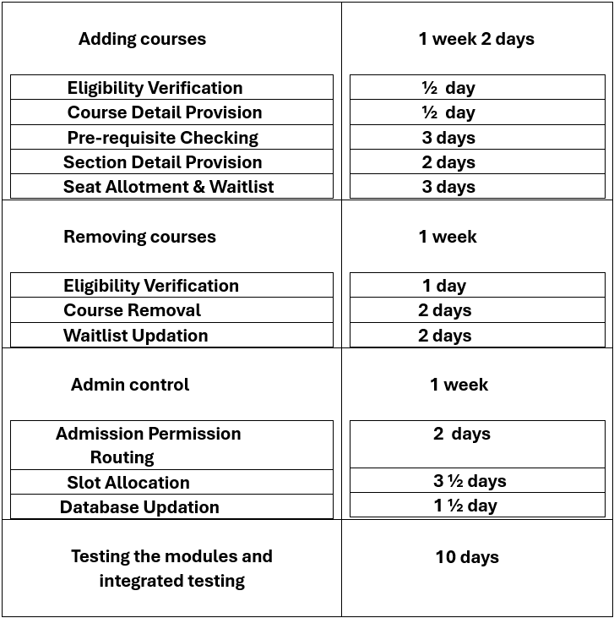
Timeline For Completing Each Modules And For Testing

Slide 27
Thank you

